Slide 1
SS ZG 526: Distributed Computing
Distributed Computation Model, and Logical Clocks
Chittaranjan Hota
Professor, Dept. of Computer Sc. & Information Systems
BITS, Pilani Hyderabad Campus, Hyderabad
hota@hyderabad.bits-pilani.ac.in

Slide 2
Vector Time
The system of vector clocks was developed independently by Fidge, Mattern and Schmuck.
In the system of vector clocks, the time domain is represented by a set of n-dimensional non-negative integer vectors.
Birla Institute of Technology and Science, Pilani (Deemed University)

Slide 3
Vector Time
Process p_{i} uses the following two rules R1 and R2 to update its clock:
R1: Before executing an event, process pi updates its local logical time as follows:
vt_{i}[i] := vt_{i}[i] + d (d > 0)
R2: Each message m is piggybacked with the vector clock vt of the sender process at sending time. On the receipt of such a message (m,vt), process p_{i} executes the following sequence of actions:
  Update its global logical time as follows:
  1≤ k≤ n : vt_{i}[k] := max(vt_{i} [k], vt[k])
  Execute R1.
  Deliver the message m.
Birla Institute of Technology and Science, Pilani (Deemed University)

Slide 4
Vector Time Example
Birla Institute of Technology and Science, Pilani (Deemed University)

Slide 5
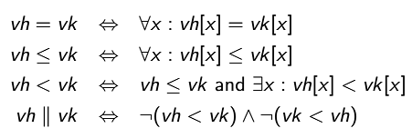

Vector Time
Comparing Vector Timestamps
The following relations are defined to compare two vector timestamps, vh and vk:
If the process at which an event occurred is known, the test to compare two timestamps can be simplified as follows: If events x and y respectively occurred at processes p_{i} and p_{j} and are assigned timestamps vh and vk, respectively, then
Birla Institute of Technology and Science, Pilani (Deemed University)

Slide 6
Vector Time
Strong Consistency
The system of vector clocks is strongly consistent; thus, by examining the vector timestamp of two events, we can determine if the events are causally related.
However, Charron-Bost showed that the dimension of vector clocks cannot be less than n, the total number of processes in the distributed computation, for this property to hold.
Event Counting
If d=1 (in rule R1), then the i^{th} component of vector clock at process p_{i}, vt_{i}[i], denotes the number of events that have occurred at p_{i} until that instant.
So, if an event e has timestamp vh, vh[j] denotes the number of events executed by process p_{j} that causally precede e. Clearly, Σvh[j] − 1 represents the total number of events that causally precede e in the distributed computation.
Birla Institute of Technology and Science, Pilani (Deemed University)

Slide 7
Efficient Implementations of Vector Clocks
If the number of processes in a distributed computation is large, then vector clocks will require piggybacking of huge amount of information in messages.
The message overhead grows linearly with the number of processors in the system and when there are thousands of processors in the system, the message size becomes huge even if there are only a few events occurring in few processors.
We discuss an efficient way to maintain vector clocks.
Charron-Bost showed that if vector clocks have to satisfy the strong consistency property, then in general vector timestamps must be at least of size n, the total number of processes.
However, optimizations are possible and next, and we discuss a technique to implement vector clocks efficiently.
Birla Institute of Technology and Science, Pilani (Deemed University)

Slide 8
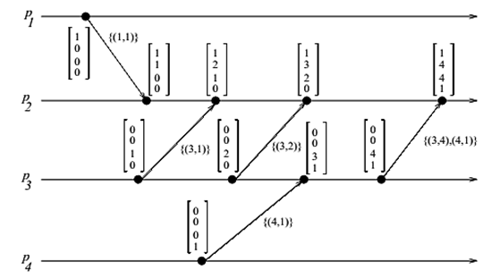
Singhal-Kshemkalyani’s Differential Technique
based on the fact that between successive message sends to the same process, only a few entries of the vector clock at the sender process are likely to change.
Birla Institute of Technology and Science, Pilani (Deemed University)

Slide 9
Next module
Global state recording and Causal ordering of
messages
Birla Institute of Technology and Science, Pilani (Deemed University)

